Slide 1
ENEL 419 PROBABILITY AND RANDOM VARIABLES
5. Continuous Random Variables and Probability Distributions
(Reading Exercises: Montgomery and Runger Chapter 4.1-4.2 & Class notes)
(Reading Exercises: Yates and Goodman Chapter 4)

Slide 2

Continuous Random Variable - Definition
A random variable $X$ is continuous if all its set of possible values belong to an entire interval of numbers. Example, $a≤X≤b$.

Slide 3
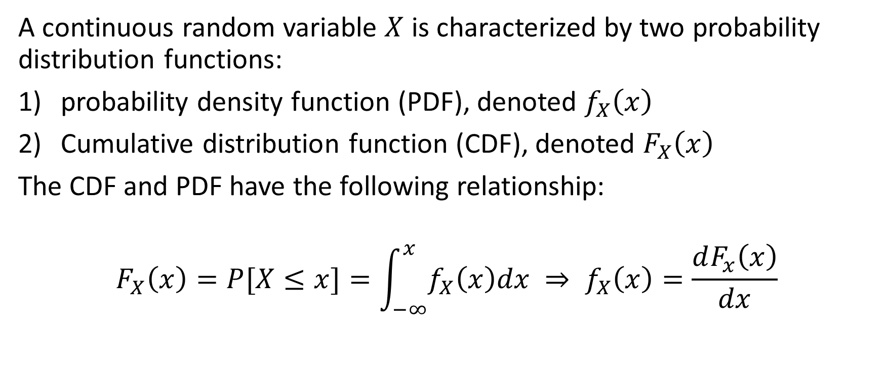
Continuous Random Variable – Probability Distributions
A continuous random variable $X$ is characterized by two probability distribution functions:
probability density function (PDF), denoted $f_{X}\left(x\right)$
Cumulative distribution function (CDF), denoted $F_{X}\left(x\right)$
The CDF and PDF have the following relationship:
$$F_{X}\left(x\right)=P[X≤x]=\int_{−∞}^{x}{f_{X}\left(x\right)dx ⇒ f_{X}\left(x\right)}=\frac{dF_{x}\left(x\right)}{dx}$$

Slide 4
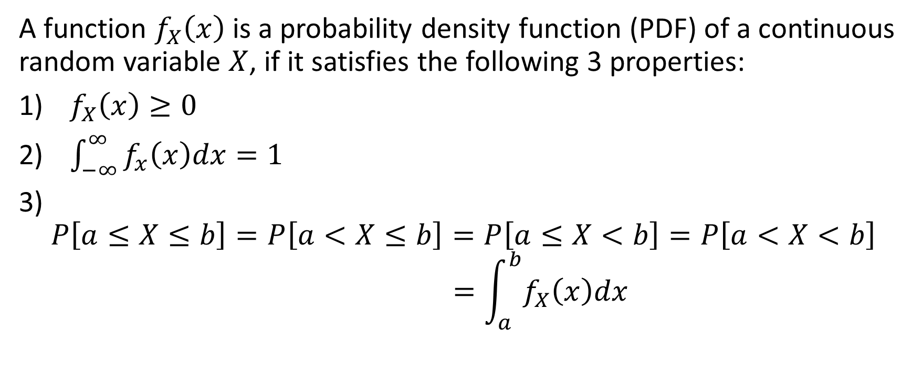
Probability Density Function
A function $f_{X}\left(x\right)$is a probability density function (PDF) of a continuous random variable $X$, if it satisfies the following 3 properties:
$f_{X}\left(x\right)≥0$
$\int_{−∞}^{∞}{f_{x}\left(x\right)dx=1}$
$$P\left[a≤X≤b\right]=P\left[a<X≤b\right]=P\left[a≤X<b\right]=P\left[a<X<b\right]$$
$$=\int_{a}^{b}{f_{X}\left(x\right)dx}$$

Slide 5
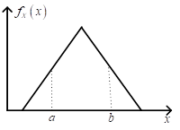

Probability of a Continuous Random Variable
The probability $P\left[a≤X≤b\right]$ is the area of the region $a≤X≤b$
For continuous random variable $X,$
$$P\left[X=constant\right]=0$$

Slide 6
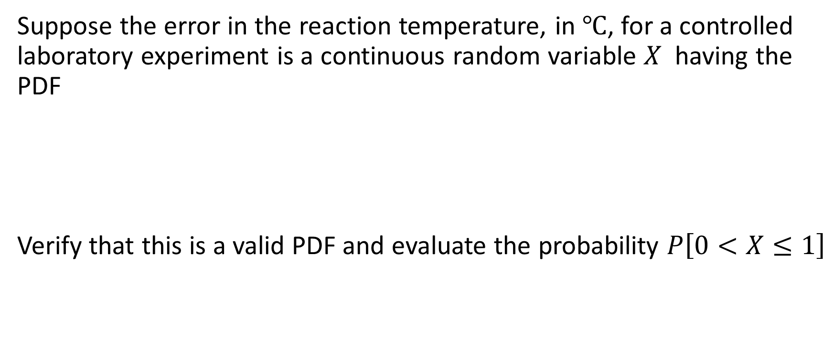
Example 1
Suppose the error in the reaction temperature, in $℃$, for a controlled laboratory experiment is a continuous random variable $X$ having the PDF
Verify that this is a valid PDF and evaluate the probability $P\left[0<X≤1\right]$

Slide 7

Example 1 Solutions
Substituting the end points, we see that $f_{X}\left(x\right)≥0$.
$$\int_{−1}^{2}{\frac{x^{2}}{3}dx={\left.\frac{x^{3}}{9}\right|}_{−1}^{2}=1}$$

Slide 8
Cumulative Distribution Function

Slide 9

Example 2
Example 2: A random variable has the probability density function
Find the CDF, $F_{X}\left(x\right)$ and use it to evaluate $P\left[0<X≤1\right]$

Slide 10

Example 2 continued
For interval $−∞<−1, F_{X}\left(x\right)=0.$
For interval $−1≤X<2$,
For interval $X≥2,$ $F_{x}\left(x\right)={\left.\frac{x^{3}+1}{9}\right|}_{x=2}=1$

Slide 11
Example 2 continued

Slide 12
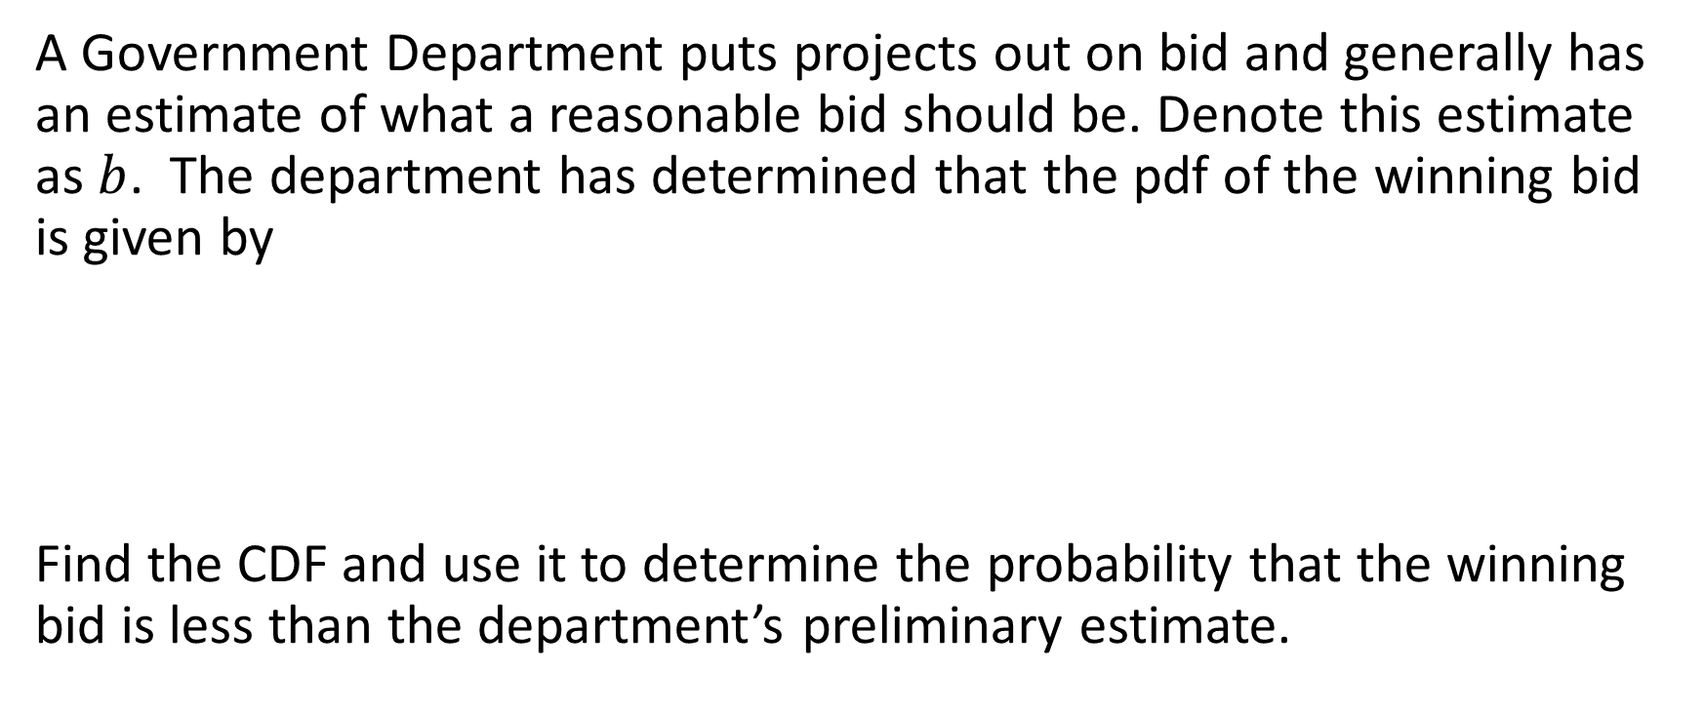
Example 3
A Government Department puts projects out on bid and generally has an estimate of what a reasonable bid should be. Denote this estimate as $b$. The department has determined that the pdf of the winning bid is given by
Find the CDF and use it to determine the probability that the winning bid is less than the department’s preliminary estimate.

Slide 13

Example 3 continued
For interval $−∞<\frac{2}{5}b, { F}_{X}\left(x\right)=0$
For interval $\frac{2}{5}b≤X<2b,$
For interval $X≥2b,$

Slide 14
Example 3 continued

Slide 15

CDF and PDF of Linear Transformations of Random Variables
A continuous random variable $X$ has CDF $F_{X}(x)$ and PDF $f_{X}\left(x\right)$. Consider a linear transformation $Y=aX+b$.
We want to express the CDF $F_{Y}(y)$ and PDF $f_{Y}\left(y\right)$, of the new random variable $Y$ in terms of the CDF $F_{X}(x)$ and PDF $f_{X}\left(x\right)$ of $X$.

Slide 16

CDF and PDF of Linear Transformations of Random Variables
New random variable is $Y=aX+b$.
Step 1: express $X$in terms of $Y$: $X=\frac{Y−b}{a}, then$
Step 2: take the derivative with respect to $Y$,

Slide 17

Example 4
A random variable $X$ has PDF given by
Find the CDF of $X$
Find the CDF of $Y=2X−1$
Find the PDF of $Y=2X−1$

Slide 18
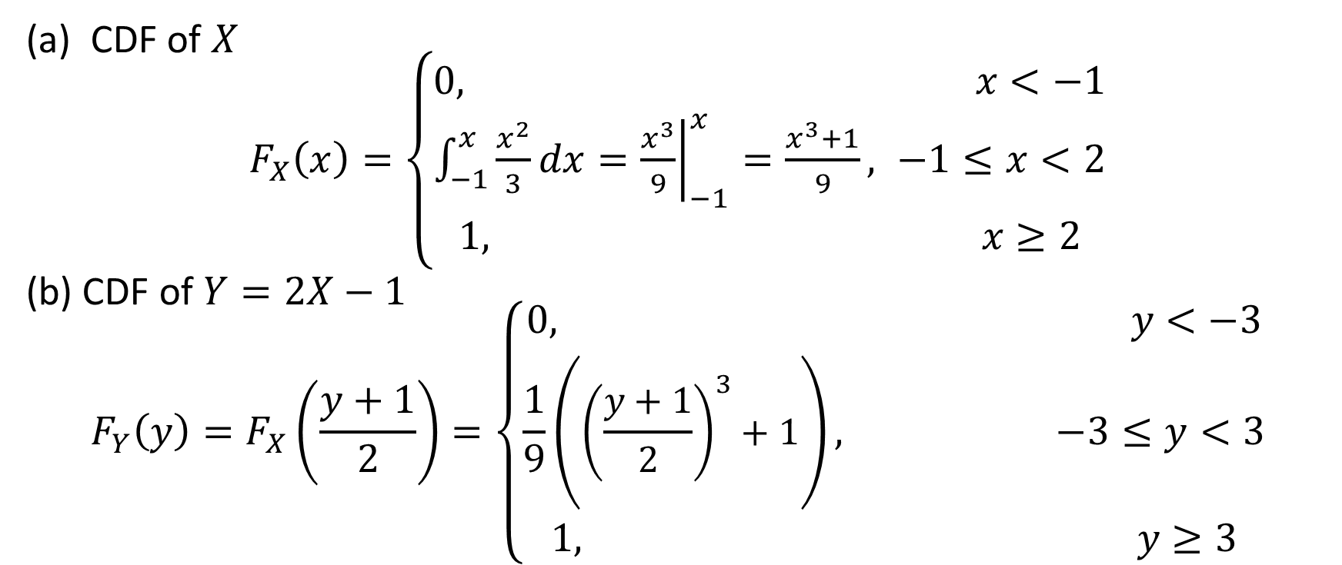
Example 4 Solutions
CDF of $X$
$F_{X}\left(x\right)=\left\{\begin{aligned}0, x<−1 \\ &\int_{−1}^{x}{\frac{x^{2}}{3}dx={\left.\frac{x^{3}}{9}\right|}_{−1}^{x}=\frac{x^{3}+1}{9}}, −1≤x<2 \\ 1, x≥2\end{aligned}\right.$
(b) CDF of $Y=2X−1$
$$F_{Y}\left(y\right)=F_{X}\left(\frac{y+1}{2}\right)=\left\{\begin{aligned}0, y<−3 \\ &\frac{1}{9}\left({\left(\frac{y+1}{2}\right)}^{3}+1\right), −3≤y<3 \\ 1, y≥3\end{aligned}\right.$$

Slide 19
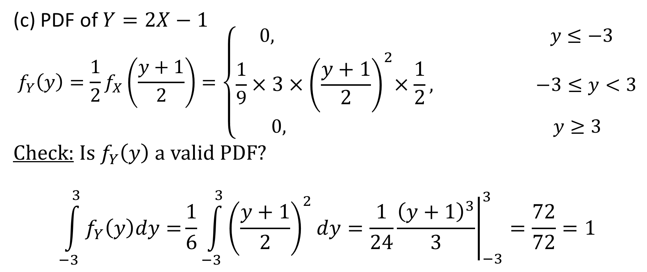
Example 4 Solutions
(c) PDF of $Y=2X−1$
$$f_{Y}\left(y\right)={\frac{1}{2}f}_{X}\left(\frac{y+1}{2}\right)=\left\{\begin{aligned}0, y≤−3 \\ &\frac{1}{9}{×3×\left(\frac{y+1}{2}\right)}^{2}×\frac{1}{2}, −3≤y<3 \\ 0, y≥3\end{aligned}\right.$$
Check: Is $f_{Y}\left(y\right)$ a valid PDF?
$$\int_{−3}^{3}{f_{Y}\left(y\right)dy=}\frac{1}{6}\int_{−3}^{3}{{\left(\frac{y+1}{2}\right)}^{2}dy=\frac{1}{24}{\left.\frac{{\left(y+1\right)}^{3}}{3}\right|}_{−3}^{3}=\frac{72}{72}=1}$$

